Slide 1
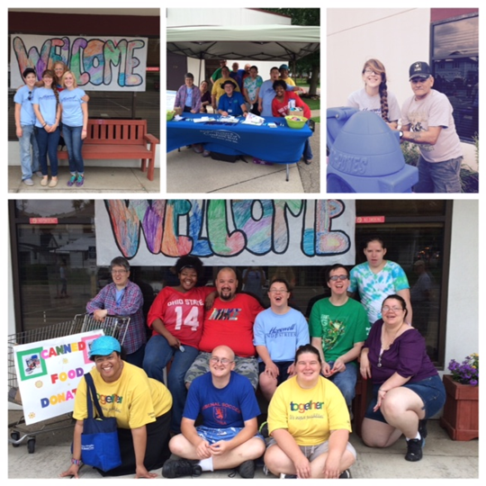
Raise your voice
WHO WE ARE:
we are self-advocates who strive to be better, to speak up and make a difference
we believe in self-determination
we want freedom to choose a meaningful life in the community
we know the importance of our leadership role in the community
we support the self-advocacy movement
we tap into resources in ways that are life enhancing
we are aware that people with disabilities can make a contribution to our communities
Raise Your Voice meets the last Wednesday of every month at the SSA Office 5:30pm to 7:00pm
If interested, call 740-622-2674

Slide 2
What we do:
We have meetings
We attend conferences
We contribute to our community
We are members of the Ohio Self Determination Association
We use knowledge from Project STIR (Steps Toward Independence and Responsibility) Trainings to practice self-advocacy
By definition, advocacy is the act or process of supporting a cause or proposal; the act or process of advocating for something. You can practice advocacy using a direct approach to influence decisions, but what is Self-Advocacy?
SELF AWARENESS-speaking up for yourself by knowing yourself
HOW TO GET THE THINGS I NEED/WANT-asking for what you need
KNOWING YOUR RIGHTS AND RESPONSIBILITIES
PROBLEM SOLVING-negotiating for yourself
USING AVAILABLE RESOURCES-for the things you need

Slide 3
This is how we do it!
Step #1: SELF-AWARENESS
WHAT I LIKE
RECOGNIZING WHAT’S IMPORTANT TO ME AND FOR ME
THINGS THAT MAKE ME SPECIAL
Step #2: KNOWING YOUR RIGHTS
WITH RIGHTS COME RESPONSIBILITIES
Step #3: EFFECTIVE COMMUNICATION
KNOWING THE DIFFERENT STYLES OF COMMUNICATION :
-aggressive (losing control of yourself, demanding instead of requesting)
-assertive (feelings are expressed and good working relationships established)
-passive (puts others in control of your life, takes away your self-determination)
Step #4: PROBLEM SOLVING
PRACTICE USING THE SPIRAL MODEL (Example to the left)
Step# 5: WHO CAN HELP ME
WHEN I NEED HELP, WHO CAN I TRUST AND HOW CAN I CONNECT WITH MY AVAILABLE RESOURCES

Slide 4
Resources for Self-Advocates
(right click to open hyperlinks)
http://www.osdaohio.org/advocacy/
http://autismnow.org/wp-content/uploads/2013/04/CurriculumForSelfAdvocates_r7.pdf
https://www.thearcofohio.org/advocacy-services.html
http://www.gmsavt.org/
http://www.osdaohio.org/training-materials/
http://www.ohioemploymentfirst.org/up_doc/OSDA_EF_Leadership_Training_Part1.pdf
http://www.pacer.org/parent/php/PHP-c116.pdf

